Slide 1
Data Warehousing - session -2
Mr. Atul Vaze
Certified BI Specialist(OBIEE)
Certified Agile Coach (ICP-ACC)
Function Point Specialist
Six Sigma GB

Slide 2
Books
Text Books:
T1: Ponniah P, “Data Warehousing Fundamentals”, Wiley Student Edition, 2012
T2: Kimball R, “The Data Warehouse Toolkit”, 3e, John Wiley, 2013
Reference Books :
R1 : Anahory S, & Dennis M, “Data Warehousing in the Real World”, Pearson Education, 2008.
R2 : Kimball R, Reeves L, Ross M, & Thornthwaite, W, “The Data Warehouse Lifecycle Toolkit”, John Wiley, 2e, 2012.
R3: Jiawei Han, Micheline Kamber and Jian Pei, “Data Mining: Concepts and Techniques”, Morgan Kaufmann Publishers 2012
R4: Krish Krishnan, “Data Warehousing in the Age of Big Data”, Morgan Kaufmann Publishers 2013
Note: In order to broaden understanding of concepts as applied to Indian IT industry, students are advised to refer books of their choice and case-studies in their own organizations

Slide 3
Agenda
  Business Processes
  Value Chain
  The Scenario
  What Managemant is interested in ?
  DW : Design Steps
  DW : Design Issues
  Dimension Tables
  Fact Table
  Database Sizing

Slide 4
Business Processes
Sales
Inventory
Procurement
Order Management
Promotion

Slide 5
Value Chain
Retailer Issues
Purchase Order
Deliveries @
Retailer WH
Retailer WH
Inventory
Retail Store
Sales
Retail Store
Inventory
Deliveries @
Retail Store

Slide 6
The Scenario
A chain of grocery stores in the US
100 stores
60,000 individual products on the shelves in each store
6,000 products (on an average) sell each day in a given store
Each product belongs to a subcategory
Each subcategory belongs to a category
Each category belongs to a department

Slide 7
Some Terms
Stock Keeping Units (SKUs): Individual products are called stock keeping units (a can of coke is a SKU). About 55,000 SKUs come from outside manufacturers and have bar codes imprinted on the product package*.
These bar codes are called Universal Product Codes (UPCs). Remaining 5,000 SKUs come from departments like meat, produce, bakery, frozen foods, or floral department. While these products don’t have nationally recognized UPCs, the grocery store assigns SKU numbers to them. Scanner labels are pasted on such products. Although the bar codes are not UPCs, they are certainly SKU numbers.
Still we may have many products like apples, where the checker has to identify the SKU at the check stand.

Slide 8
What Management is Interested In?
Ordering logistics
Stocking shelves
Selling products
Maximize profits

Slide 9
PROMOTION
The profit comes from
  Charging as much as possible for each product
  Lowering cost for product acquisition and overhead
And at the same time attracting as many customers as possible in a highly competitive pricing environment. Pricing and promotions play a vital role in all this and the management spends a great amount of time tinkering with pricing and promotions.
Promotions in a grocery store generally include
  Temporary Price Reductions (TPRs)
  Ads in newspapers
  Inserts in newspapers
  Displays in grocery store (shelf displays and end of aisle displays)

Slide 10
Data Warehouse:
Design Steps
Step 1: Identify the Business Process
We will model the sales process
Step 2: Declare the Grain
We will keep the most granular data (an individual line in the EPOS receipt)
Note that each line in an EPOS receipt contains individual product (SKU) and its selling price along with other details like product description and quantity.

Slide 11
Data Warehouse:
Design Steps
Step 3: Identify the Dimensions
The dimensions identified are date/time, product, store, and promotion
Step 4: Identify the Facts
The facts are quantity sold, dollar revenue, dollar cost, and customer count

Slide 12
Star Schema
Product
Dimension
Location
Dimension
        FK FK
        FK FK
Sales Fact
Table
Time
Dimension
Promotion
Dimension

Slide 13
The “Classic” Star Schema
Fact Table
Store Dimension
STORE KEY
PRODUCT KEY
Time Dimension
STORE KEY
PERIOD KEY
PERIOD KEY
Store Description
City
State
District ID
District Desc.
Region_ID
Region Desc.
Regional Mgr.
Dollars_sold
Units
Dollars_cost
Period Desc
Year
Quarter
Month
Day
Product Dimension
PRODUCT KEY
Product Desc.
Brand
Color
Size
Manufacturer

Slide 14
Data warehouse :
Design Issues
The most popular schema design for data warehouses is the Star Schema
Each dimension is stored in a dimension table and each entry is given its own unique identifier.
The dimension tables are related to one (or more) fact tables.
The fact table contains a composite key made up of the identifiers from the dimension tables.
The fact table also contains facts about the given combination of dimensions. For example a combination of store_key, time_key and Product_key giving the amount of a certain product sold during the time period at a given store location.
Notice that DW design is quite different from OLTP design. One reason is that we will not use a DW for OLTP-like operations such as concurrent updates, etc.
In fact, apart from the loading of data into the DW (likely done during off hours), there are no writes to the DW
Fact tables are normalized, whereas dimension tables are not

Slide 15
Types of Facts
Fully-additive-all dimensions
  Units_sold, Sales_amt
Semi-additive-some dimensions
  Account_balance, Customer_count
  28/3,tissue paper,store1, 25, 250,20
  28/3,paper towel,store1, 35, 350,30
  Is no. of customers who bought either tissue paper or paper towel is 50? NO.
Non-additive-none
  Gross margin=Gross profit/amount
  Note that GP and Amount are fully additive
  Ratio of the sums and not sum of the ratios

Slide 16
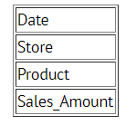
Types of Facts – Additive
Additive facts are facts that can be summed up through all of the dimensions in the fact table.
The purpose of this table is to record the sales amount for each product in each store on a daily basis. Sales_Amount is the fact. In this case, Sales_Amount is an additive fact, because you can sum up this fact along any of the three dimensions present in the fact table -- date, store, and product. For example, the sum of Sales_Amount for all 7 days in a week represents the total sales amount for that week.

Slide 17
Types of Facts – Additive
Additive facts are facts that can be summed up through all of the dimensions in the fact table.
The purpose of this table is to record the sales amount for each product in each store on a daily basis. Sales_Amount is the fact. In this case, Sales_Amount is an additive fact, because you can sum up this fact along any of the three dimensions present in the fact table -- date, store, and product. For example, the sum of Sales_Amount for all 7 days in a week represents the total sales amount for that week.
Semi-Additive: Semi-additive facts are facts that can be summed up for some of the dimensions in the fact table, but not the others.
Non-Additive: Non-additive facts are facts that cannot be summed up for any of the dimensions present in the fact table.

Slide 18
Facts for Retail Sales
Quantity sold (additive)
Dollar revenue (additive)
Dollar cost (additive)
Customer count (semi-additive, not additive along the product dimension)

Slide 19
Fact Table for Grocery Store
Field name
Example Values
Description/Remarks
Date key (FK)
1
Surrogate key
Product key (FK)
1
Surrogate key
Store key (FK)
1
Surrogate key
EPOS transaction no.
100
Trancsaction number generated by the Operational system to record sales
Sales Quantity
2
No. of units bought by a customer
Sales amount
72
Amount received by selling 2 units
Cost amount
65
Cost price of 2 units

Slide 20
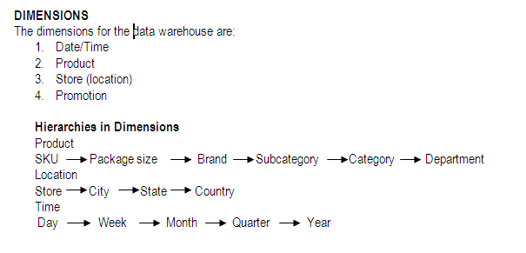
Dimensions and Hierarchies

Slide 21
Promotion Dimension
Causal Dimension
Which causes or being the cause
Promotion conditions include
  TPRs
  End-aisle displays
  Newspapers ads
  Coupons
  Combinations are common

Slide 22
Promotion Dimension
Management is interested in knowing how effective their promotion schemes are
Promotion are judged on the basis of:
  Lift and Baseline sales
  Time shifting
  Cannibalization
  Growing the market

Slide 23
Some Terms
Lift and Baseline Sales: When the products under promotion experience a gain in sales during the promotional period. This is called LIFT. This lift is measured wrt baseline sales, a figure decided by the store management about the sales of promoted products without the promotion.
Time Shifting: When the products under promotion showed a drop in sales after the promotion, thereby canceling the gain in sales during the promotion period
Cannibalization: When the products under promotion showed a gain in sales but other products nearby n the shelf showed a corresponding decrease in sales
Growing the Market: When all the products in the promoted category experience a net overall gain in sales taking into account the time periods before, during, and after the promotion.

Slide 24
Modeling Promotion Dimension
Difficult to capture the effect of promotion
Little or NO provision in operational system to capture promotions
Multiple promotion schemes at the same time
Promotion schemes applicable to many products
Different grain than sales
What about products that were on promotion but not sold?

Slide 25
Modeling Promotion Dimension
Captures combination of promotion techniques in effect at the time of sale
Promotions are generally at a higher grain than sales fact table
Adding a promotion dimension is thus possible
Promotion and product relationship is captured implicitly in the fact table
But we are missing out on one important piece of information
Products on promotion that did not sell

Slide 26
Modeling Promotion Dimension
Different causal conditions are highly correlated
Create one row for each combination of promotion conditions
All stores run 3 promotion mechanisms simultaneously, but a few stores are not able to deploy end-aisle displays
  One record for combination of 3
  One record for combination of 2

Slide 27
Modeling Promotion Dimension
In one year, there may be 1000 ads, 5000 TPRs, and 1000 end-aisle displays
Only 10000 combinations of these three conditions affecting a particular product
A sample promotion dimension
Promotion key Coupon type
Promotion name Ad media type
TPR type Display Provider
Promotion Media type Promotion Cost
Ad type Start Date
Display type End Date……
Include a NO promotion in effect row in promotion dimension

Slide 28
Modeling Promotion Dimension
Promotion Coverage Factless Fact Table
  Same Dimensions apply as that for Sales fact table
  So what is different?
  Is the grain different?
  One row in the fact table for each product in a store each day ( or week ) regardless of whether the product was sold or not
  NO FACTS INVOLVED!!
  How to find products that were on promotion on a day but did not sell?

Slide 29
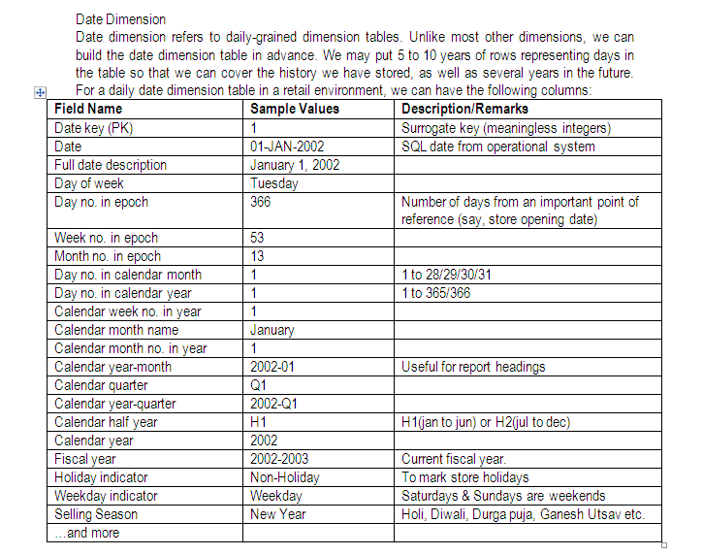
Date Dimension

Slide 30
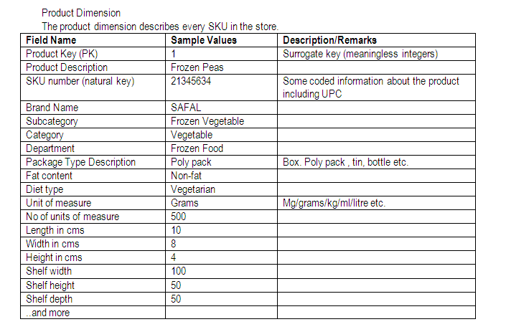
Product Dimension

Slide 31
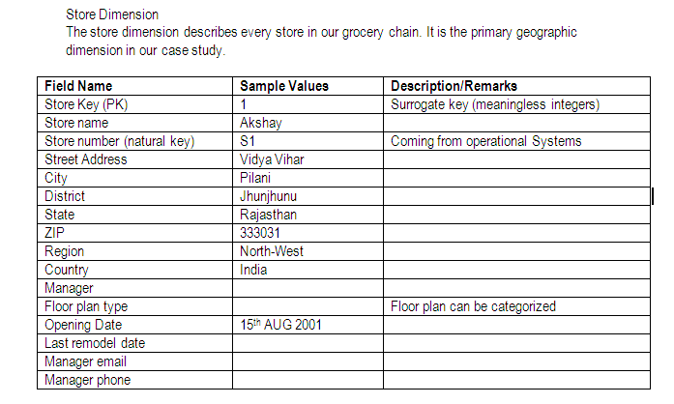
Store Dimension

Slide 32
Database Sizing
FACT TABLE SIZE
We will approximately find out the size of the fact table by making the following few assumptions:
  All the field widths are 4 bytes wide (note that this is a reasonable assumption)
  The additive numeric data values are 4 bytes*
Let us also assume that there we have data of 2 years in the data warehouse.
Time dimension: 2 years x 365 days = 730 days
Store dimension: 100 stores reporting sales each day
Product dimension: 60,000 products in each store, of which 6,000 sell each day in a given store
Number of base fact records = 730x100x6000 = 438 million
Number of key fields = 3
Number of fact fields = 4
Total fields = 7
Base tact table size = 438 million x 7 fields x 4 bytes = 12.264 GB

Slide 33
Thank You
Any Questions?

